Slide 1
Color-Logic Support
Minimum System Requirement
DFE v5.IR7.2
IMPORTANT MESSAGE
There is a bug with the ESKO imposition software when running Color-Logic formatted jobs. Until that bug has been fixed, users should use HPs Power layout standalone plugin for imposition. Please contact your local HP support team for updated information on this issue. For any technical support requests for the HP Indigo invert solution for Color-Logic, please contact your HP support channel.

Slide 2
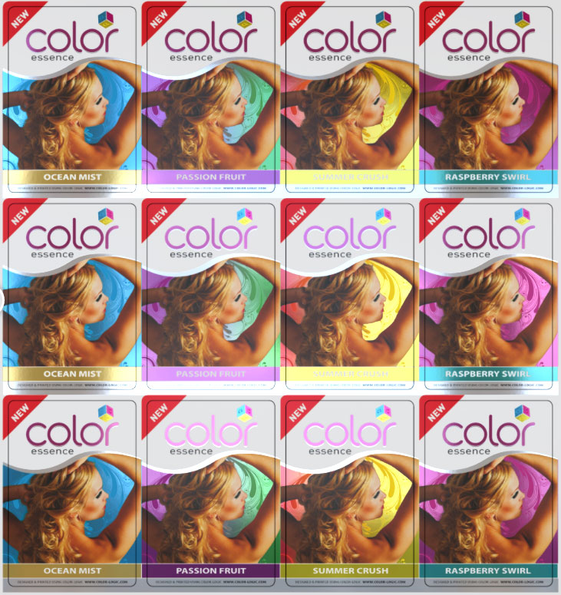
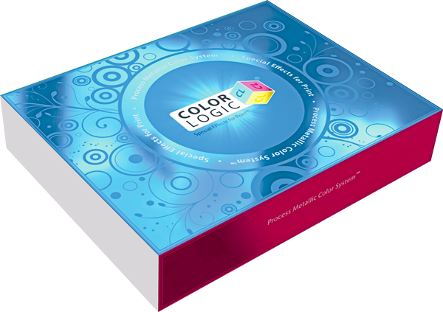
Color-Logic Support
For more information about Color-Logic go to: http://www.color-logic.com/
Notes:
Version 5.2 introduces a special support for Color Logic SW solution,
The feature is oriented for color logic customers that wants to create (click) metalized and special effects printing on the Indigo presses.

Slide 3
Color-Logic Solution
The basics behind how Color-Logic works:
+
For Adobe CS and CC
250 new foil/metallic colors!
Notes:
Lets have some background on color logic solution:
Process Metallic Color System™ is a software solution that allows the user to create a variety of metallic colors and special printing effects, using only (click) single Silver ink + (click) CMYK inks to produce up to (click) 250 different metallic colors.
The SW comes as a plugin, installed on graphic design applications such as PhotoShop(click) , Illustrator(click) and InDesign(click) .

Slide 4
On the Indigo press – Color-Logic invert for White separation
+
=
White ink on a metalized substrate
CMYK
Metalized effects
Notes:
The new feature enables to use a metallic substrate (click) instead of silver ink to create the same effect.
the Silver ink will be mapped to White (click)
and the white separation percentages will be inverted: zero percent will become one hundred percent and vice-versa. Any other silver ink Tint will be inverted in a linear way. that means that forty percent will become sixty percent and so on…
By using process inks (click) on metallic substrate only, you can achieve up to 250 (click)metallic colors and special effects.

Slide 5
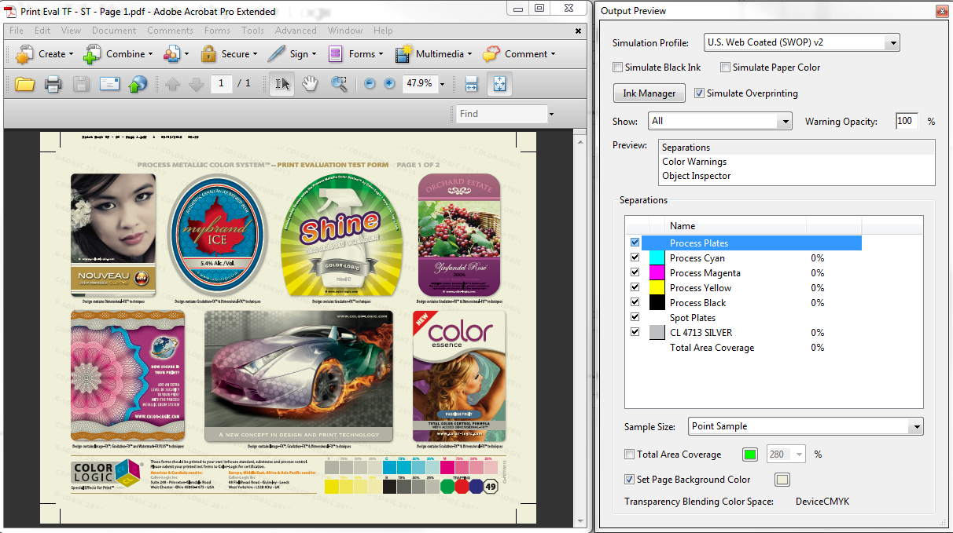
Example of a typical Color-Logic job saved as a PDF:
Notes:
The PDF file created by color Logic contain the separations CMYK and a spot color named CL 4713 SILVER

Slide 6
How do we use it? (Video)
Import the color strategy and ink library to the color engine
Notes:
there will be 2 new assets at the extra folder in the installation folder. Import those assets to the color engine:
The Ink library COLOR LOGIC contains the ink name CL 4713 SILVER, (with LAB values: 80,0,0), you can alternatively create new spot color on the Designer ink library with this exact name and LAB values.
on the Color strategy, the silver ink is mapped to white separation. The White is defined as extra output separation.

Slide 7
Importing the job to the esko server (Video)
Notes:
The next step is to import the job to the esko server
Choose the file,
Define the color logic as the custom ink book,
Choose the color logic color strategy
Go to the separation tab A new check box was added to the Job properties : Invert White Separation
By choosing it, the silver and white separations will invert.
Check it and rip the file.
Open the preview to see the results

Slide 8
TIP:
Color-Logic Spot Color Naming Convention:
CL 4713 SILVER (LAB 80,0,0)
You can add the spot color to the Designer ink library and map it manually to any selected color strategy, instead of using the default Color-Logic assets. You can use any color strategy that contains White as an extra output separation
Notes:
The Color Logic feature is based on using the silver spot ink (Click) and mapping it to White. (click) Therefore, the user can add it as a new spot color to the custom ink library and map it manually to the selected color strategy, instead of using the default CS+Ink library. You can use any color strategy that contains White as an extra output separation

Slide 9
QUICK START GUIDE
The following slides visually indicate how to adjust color curves to meet color standards, such as G7, and then apply the Color-Logic invert LUT to the job.
Notes:
The Color Logic feature is based on using the silver spot ink (Click) and mapping it to White. (click) Therefore, the user can add it as a new spot color to the custom ink library and map it manually to the selected color strategy, instead of using the default CS+Ink library. You can use any color strategy that contains White as an extra output separation

Slide 10
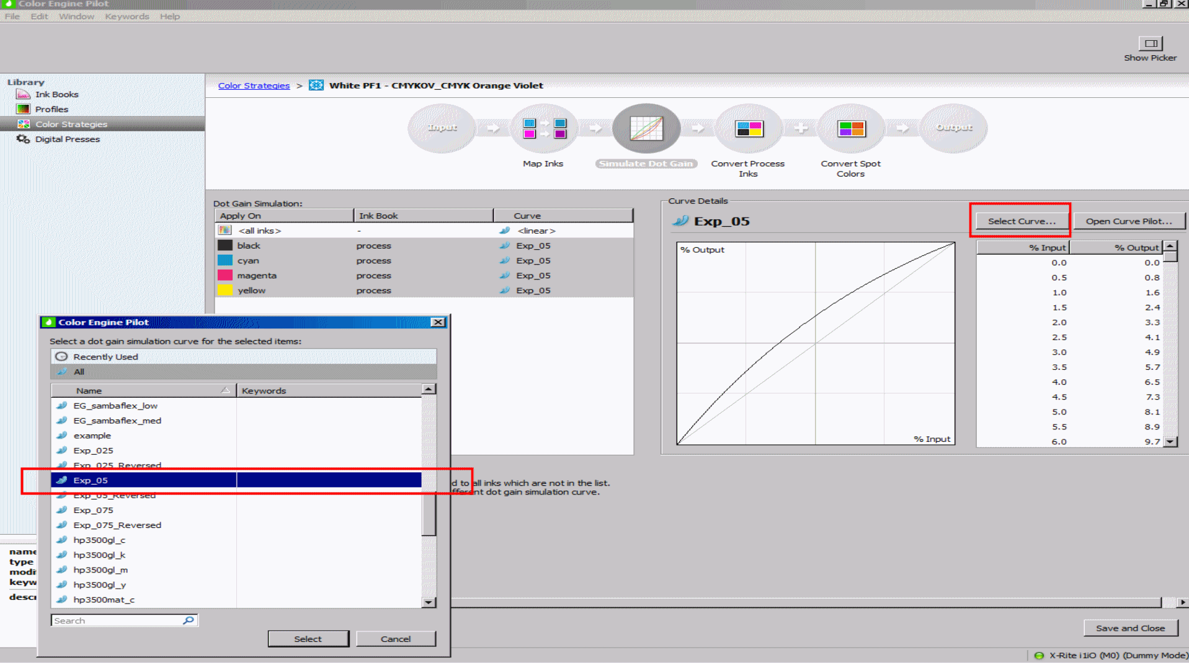
Step 1:
Apply curve in a color strategy
Notes:
The Color Logic feature is based on using the silver spot ink (Click) and mapping it to White. (click) Therefore, the user can add it as a new spot color to the custom ink library and map it manually to the selected color strategy, instead of using the default CS+Ink library. You can use any color strategy that contains White as an extra output separation

Slide 11
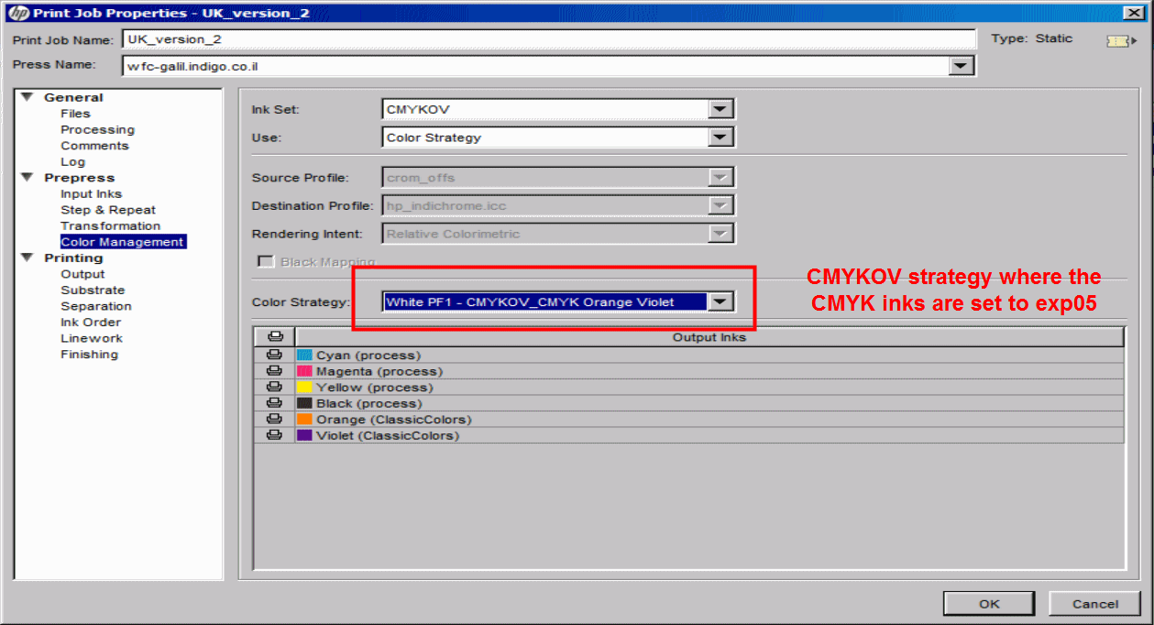
Step 2:
Apply the strategy to the job
Notes:
The Color Logic feature is based on using the silver spot ink (Click) and mapping it to White. (click) Therefore, the user can add it as a new spot color to the custom ink library and map it manually to the selected color strategy, instead of using the default CS+Ink library. You can use any color strategy that contains White as an extra output separation

Slide 12
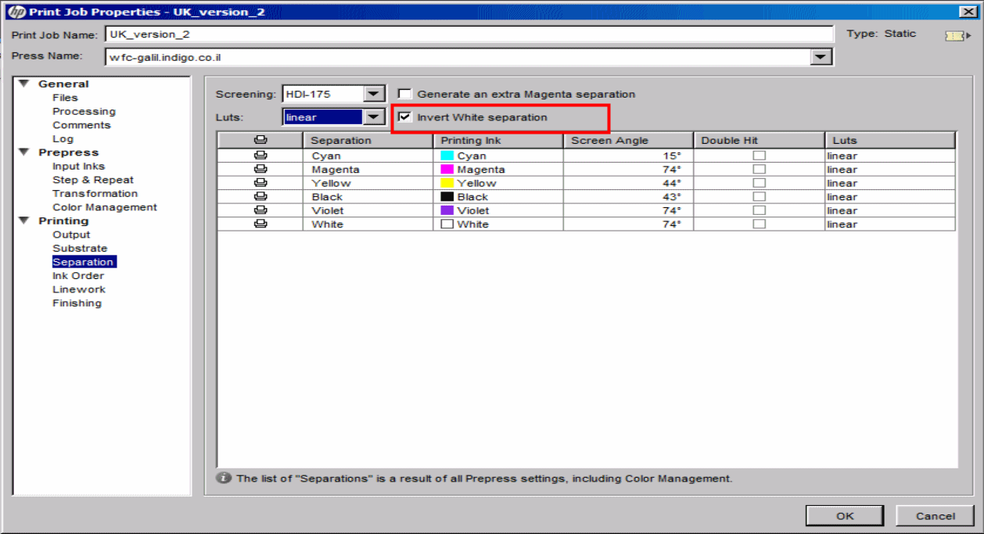
Step 3:
Apply the inverted white separation in job properties
Notes:
The Color Logic feature is based on using the silver spot ink (Click) and mapping it to White. (click) Therefore, the user can add it as a new spot color to the custom ink library and map it manually to the selected color strategy, instead of using the default CS+Ink library. You can use any color strategy that contains White as an extra output separation

Slide 13
Important notes:
LUT selection for the White separation is enabled regardless the invert selection.
The option is available in Dynamic workflow only (not supported for FlexRip)
In case of a Duplex job, the Invert White separation checkbox shall also be available for the back side – unchecked by default.

